Slide 1
FORENSICS TOOL
GROUP-3

Slide 2
WHO ARE PART OF IT ?
MENTOR - SHIVANI ARYA
MEMBER - GAGANDEEP SHUBHAM
TOTAL OF- 8 members

Slide 3
WHAT IT IS?
It is python script , that provides common platform for forensics on database of
FIREFOX
SKYPE
PCAP FILE(FROM WIRESHARK)
IP LOCATE
It is useful for a forensics investigator, or a friend who wants to investigate what his friend is doing with his system.

Slide 4
DATABASE USED
FIREFOX- firefox_cookies.db
firefox_places.db
SKYPE- main.db
IP LOCATION -GeoLiteCity.dat

Slide 5
WHAT IT PROVIDES(OUTPUT)
FIREFOX- 1.websites visited with date and time
2.cookies name with host
SKYPE- 1.User name, location
2.user name with chat
IP EXTRACTOR (Source & Destination)from PCAP file
Location of IP provided

Slide 6
WORKING
INDEX
GeoLiteCity
FIREFOX_HISTORY
FIREFOX COOKIES
SKYPE_USER
SKYPE_CHAT
PCAP EXTRATOR
IPLOCATION

Slide 7
.
LINK TO DB DIAGRAM

Slide 8
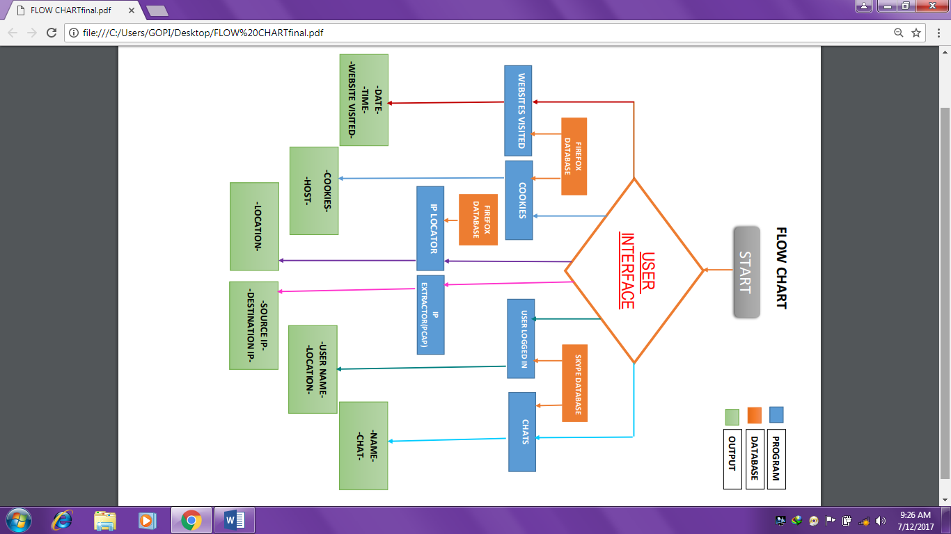
.
.

Slide 9
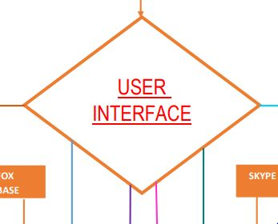
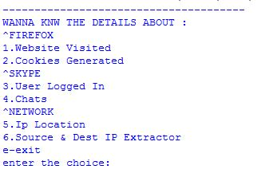
USER INTERFACE

Slide 10
.
THANK YOU

